Slide 1
DESIGN AND IMPLEMENTATION OF A GEO-FENCED MOBILE ATTENDANCE MONITORING SYSTEM FOR ACADEMIC INSTITUTIONS
BY
ESSIEN ABASIAMA
20201742
DEPARTMENT OF ELECTRICAL ELECTRONIC ENGINEERING
COLLEGE OF ENGINEERING
FEDERAL UNIVERSITY OF AGRICULTURE, ABEOKUTA
ENGR. MATTHEW SIMEONE
DECEMBER, 2025.

Slide 2
Introduction
Background to the study
Traditional manual and basic digital attendance systems are prone to impersonation and location-based fraud, reducing the reliability of attendance records.
Modern smartphones support GPS, biometric authentication, and real-time connectivity, enabling secure and automated attendance solutions.
Geofencing technology restricts attendance marking to defined lecture locations, ensuring physical presence verification.

Slide 3
Introduction Cont’d
Statement of Problem
Attendance fraud through proxy signing and remote check-ins
No mechanism to verify continuous presence during lectures
Limited lecturer control over attendance processes

Slide 4
Introduction Cont’d
Aim and Objectives
Aim:
To design and implement a Geo-Fenced Mobile attendance monitoring system for academic Institutions
Objectives:
To implement a secure attendance verification system using device binding and biometric authentication to ensure accurate student identity validation.

Slide 5
Introduction Cont’d
Aim and Objectives
Objectives:
To enforce geo-fenced lecture locations so that attendance can only be recorded when students are physically present within designated lecture venues.
To enable timed and randomized attendance checks for continuous verification of student presence throughout the lecture duration.
To provide real-time attendance monitoring and analytical reporting tools to support effective decision-making by lecturers and academic administrators.

Slide 6
Introduction Cont’d
Justification of the Study
Enhances accuracy and credibility of attendance records
Improves academic discipline and accountability
Reduces manual workload for lecturers
Demonstrates real-world application of EEE principles

Slide 7
Introduction Cont’d
Scope of Study
Development of a mobile-based attendance monitoring system for university lecture halls using embedded smartphone sensors and communication modules.
Focus on system design, implementation, and integration, combining sensing, control logic, data processing, and wireless communication components.
Utilization of existing smartphone hardware and cloud-based infrastructure for data acquisition, processing, storage, and system control.

Slide 8
Literature Review
Attendance Approach | Description | Key Limitations
Conventional Systems | Manual or basic digital attendance methods | High error rates, prone to manipulation and spoofing
RFID / Biometric-Based Systems | Use RFID cards or biometric identifiers for authentication | Require dedicated hardware; limited mobile platform integration
GPS-Based Systems | Verify user presence based on geographical location | Weak user authentication; no continuous presence monitoring
Integrated Cyber-Physical Systems | Combine geofencing, biometric verification, and device binding | Limited implementation in existing studies, indicating a research gap

Slide 9
Identified Research Gaps
Lack of integrated geo-fencing and biometric systems
Minimal use of device binding in attendance systems
Limited lecturer-controlled attendance models
Poor engineering-oriented system integration

Slide 10
Materials and Methods
Materials
1. Hardware Components
Smartphones (Android/iOS): Equipped with GPS, front-facing cameras, accelerometers, and wireless communication modules.
Server Infrastructure: Cloud-based servers for data processing, storage, and system control.
Development Workstations: Laptops or desktops for software development, simulation, and testing.

Slide 11
Materials and Methods
Materials
2. Software and Development Tools
Mobile Application Development: React Native with JavaScript/TypeScript for cross-platform deployment.
Backend and API Development: Laravel (PHP framework) implementing RESTful API architecture.
Database Management: MySQL or PostgreSQL for relational data storage and query optimization.
Cloud Infrastructure: Linux-based servers (Ubuntu) with Nginx/Apache, SSL security, and automated backups.

Slide 12
Materials and Methods Cont’d
Materials
3. External APIs and Libraries
Google Maps and Geolocation APIs for accurate positioning.
Geofencing APIs to enforce spatial boundaries.
Face Recognition Libraries (TensorFlow Lite, FaceNet) for biometric verification.
Device Fingerprinting Libraries for secure device identification.
Axios for secure client-server communication.

Slide 13
Materials and Methods Cont’d
Methodology
Adopted a Design and Development Research (DDR) approach for systematic problem analysis, system modelling, implementation, and evaluation.
Implemented a three-tier client–server architecture comprising presentation, application, and data layers for modularity and scalability.
Developed a mobile application integrated with a backend server (Laravel) and relational database(MySQL) to handle attendance recording, processing, and storage.
Leveraged embedded smartphone sensors, GPS, geofencing, biometric authentication, and wireless communication for secure and real-time attendance verification using react native technology.

Slide 14
Materials and Methods Cont’d
Methodology: GPS Positioning & Geofencing (I)
A student's position P = (φₚ, λₚ) is sampled N = 5 times at the highest GNSS accuracy and averaged to suppress random satellite noise:
P̄ = ( (1/N)·Σ φᵢ , (1/N)·Σ λᵢ ) (3.1)
The great-circle distance to the venue centre uses the Haversine formula:
a = sin²(Δφ/2) + cos φ₁ · cos φ₂ · sin²(Δλ/2) (3.2)
c = 2 · atan2( √a , √(1 − a) ) (3.3)
d = R · c , R = 6 371 000 m (mean Earth radius) (3.4)
where d is the distance (m) between the student and the venue centre; φ, λ are latitude/longitude in radians.

Slide 15
Materials and Methods Cont’d
Methodology: Geofencing — Boundary Decision (II)
Circular venue (centre C = (φ₀, λ₀), radius r): the student is admitted if and only if the Haversine distance is within the radius:
Inside ⇔ d ≤ r (3.5)
Polygon venue: the ray-casting (even–odd) rule. A horizontal ray is cast from P; for each edge (Vᵢ, Vⱼ) the crossing test is:
(yᵢ > yₚ) ≠ (yⱼ > yₚ) ∧ xₚ < (xⱼ − xᵢ)(yₚ − yᵢ)/(yⱼ − yᵢ) + xᵢ (3.6)
An ODD number of edge crossings ⇒ the point lies inside the boundary.
where (x, y) = (longitude, latitude); the reported GNSS accuracy is stored with each record so near-boundary decisions can be audited.

Slide 16
Materials and Methods Cont’d
Methodology: Biometric (Face) Verification
A live selfie is reduced to a descriptor and compared with the student's enrolled reference face.
(a) On-device perceptual-hash matcher:
Y = 0.299R + 0.587G + 0.114B (grayscale luminance) (3.7)
μ = (1/N²)·Σ Yᵢ ; bᵢ = 1 if Yᵢ ≥ μ, else 0 (256-bit hash) (3.8)
D(Hᵣ, Hₗ) = Σ (bᵣ,ᵢ ⊕ bₗ,ᵢ) ; Confidence = 100·(1 − D/256) % (3.9)
(b) Deep-CNN matcher (AWS Rekognition embeddings f ∈ ℝⁿ):
S(fᵣ, fₗ) = (fᵣ · fₗ) / (‖fᵣ‖ ‖fₗ‖) (cosine similarity) (3.10)
Verified ⇔ S × 100 ≥ T (acceptance threshold T = 70%) (3.11)

Slide 17
Materials and Methods Cont’d
Methodology: Binding, Timing & Composite Decision
Device binding (one account ↔ one phone) — every sensitive request must carry the bound device fingerprint:
Allow ⇔ Uᵣₑǫ = Uᵇₒᵤₙᵈ ∧ revoked_at = NULL (3.12)
Lateness and status inside the active window [tₛ, tₑ]:
m = t − tₛ ; Status = PRESENT if m ≤ τ, else LATE (3.13)
Continuous presence (randomised checks every interval I); a record is valid throughout when no check is missed:
PresentThroughout ⇔ M = 0 (3.14)
Final decision — all gates must hold simultaneously:
Granted = B ∧ G ∧ F ∧ W (3.15)
B = bound device, G = inside geofence, F = face verified, W = within time window.

Slide 18
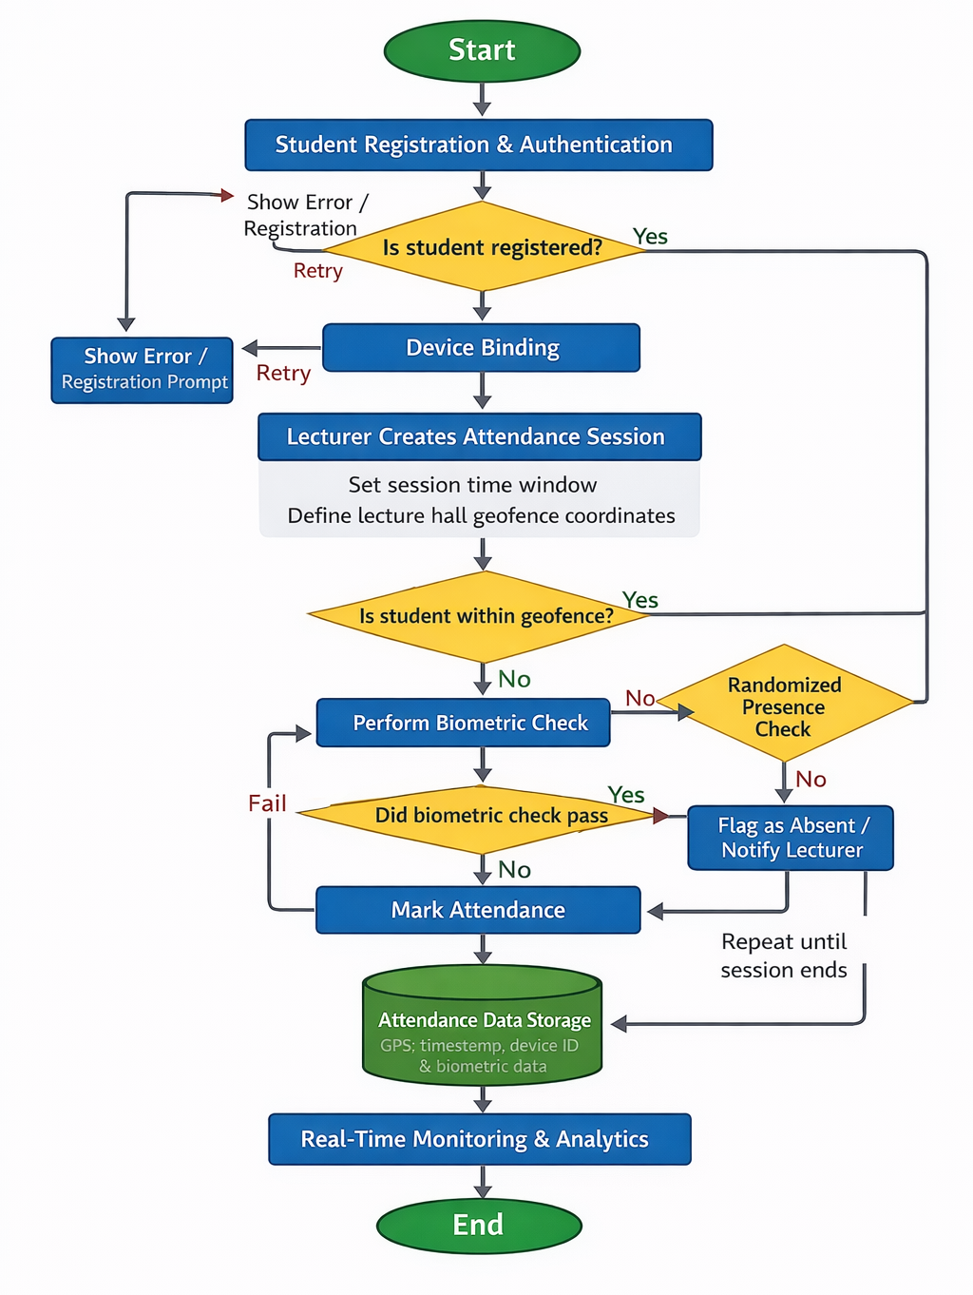
System Workflow/Flowchart Diagram
No
Yes
Yes

Slide 19
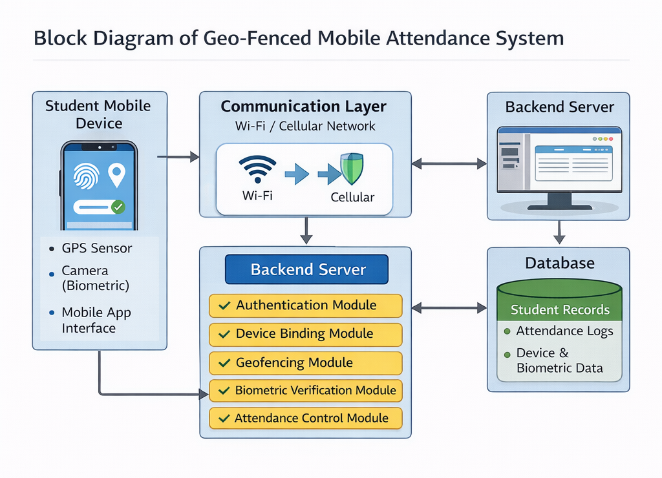
BlockDiagram

Slide 20
Expected Results
Elimination of attendance fraud through device binding, biometric verification, and geofencing controls.
Accurate verification of physical presence using GPS-based location tracking and continuous monitoring during lectures.
Real-time monitoring and reporting via mobile interfaces and cloud-based data processing for lecturers and administrators.
Improved efficiency in attendance management by automating record-keeping, analytics, and system control.

Slide 21
Results and Discussion
This chapter presents results from the implementation, testing, and evaluation of the GeoTrack geo-fenced mobile attendance monitoring system.
Testing followed the path a real attendance takes: account registration and device binding, location (geofence) verification, identity (face) verification, the check-in decision, the timed attendance window with randomised presence checks, and notification delivery and dashboard reporting.

Slide 22
Results and Discussions Cont’d
Results cover positioning accuracy, face-verification performance, correctness of the check-in decision under both legitimate and fraudulent conditions, system response times, and platform stability under continuous and concurrent use.

Slide 23
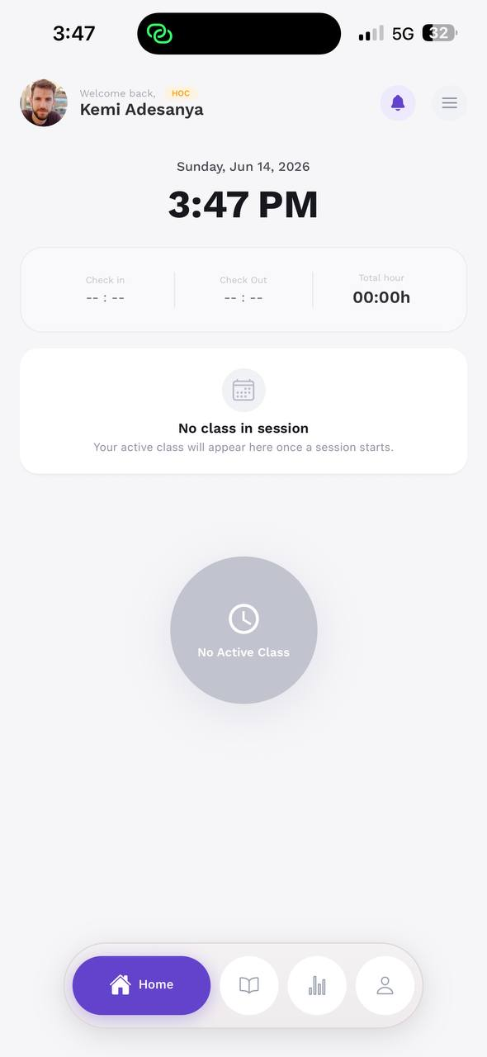
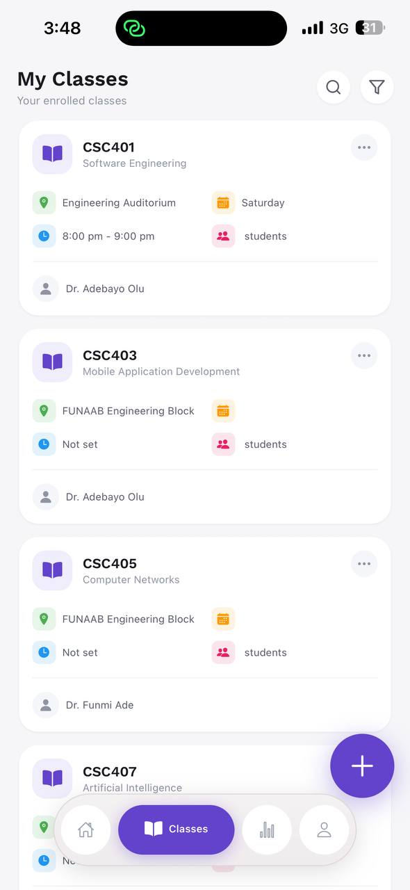
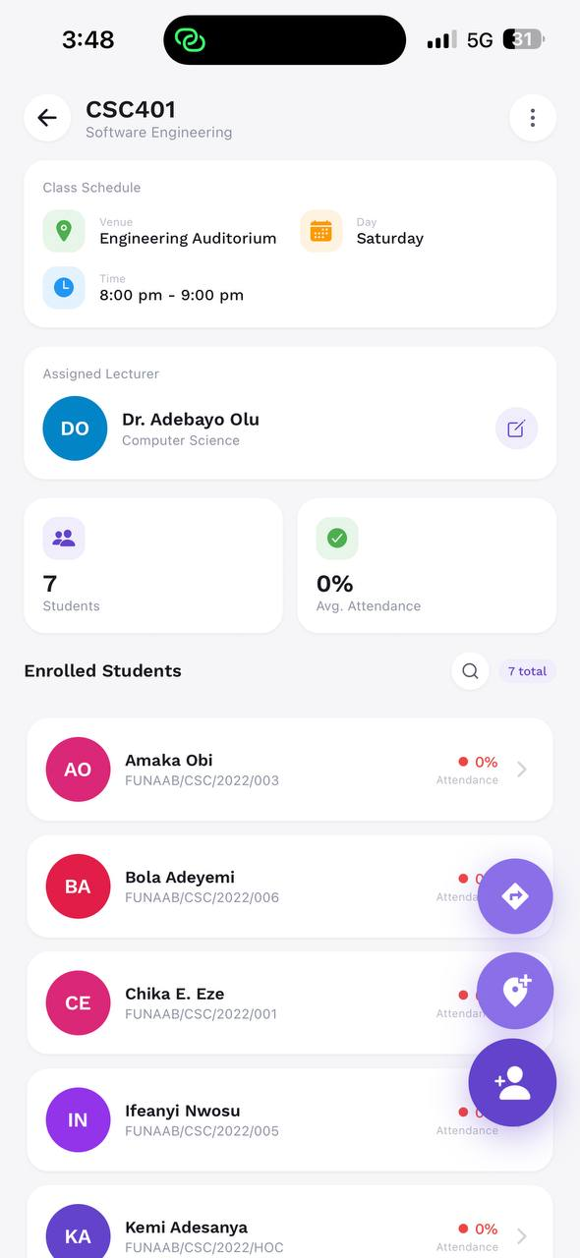
System Implementation
Implemented as a three-tier client–server application matching the Chapter Three architecture.
Presentation layer: React Native mobile app; application layer: Laravel RESTful backend; data layer: relational database.
All layers communicate over secure HTTPS, with token-based sessions and a bound-device identifier on every sensitive request.
All modules integrated and confirmed functional before testing.
Figure 4.1: Home, class list, and class detail screens of the GeoTrack application
3

Slide 24
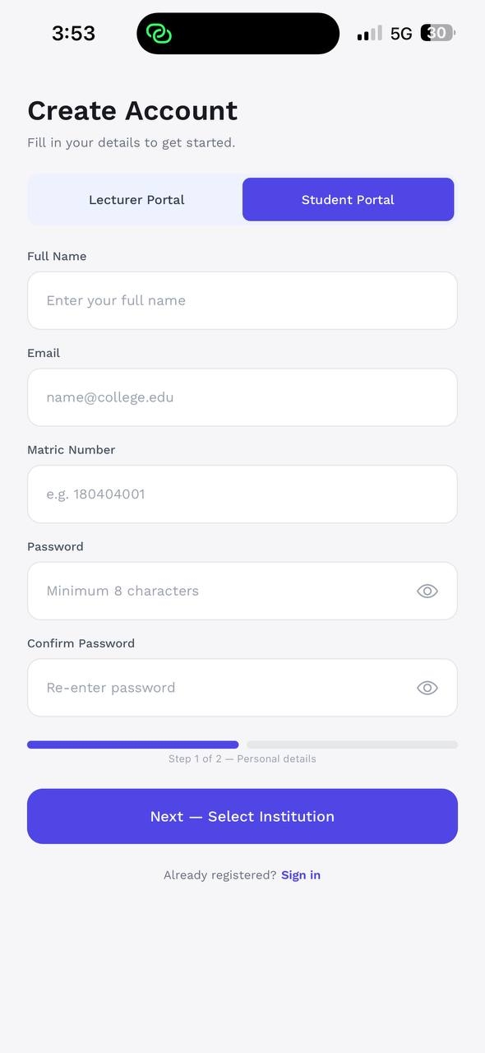
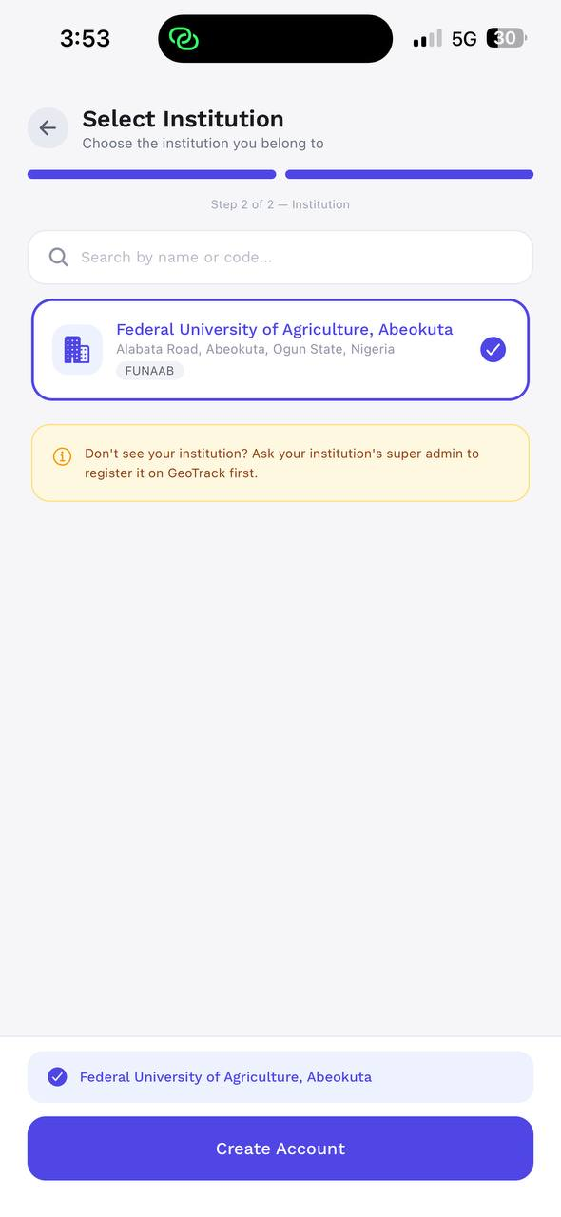
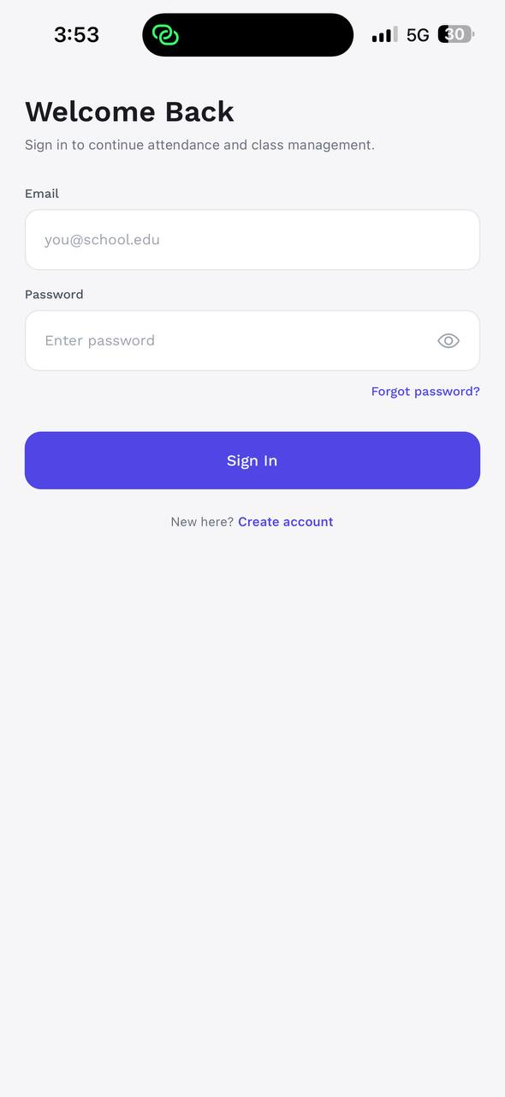
User Registration & Device Binding
Account Registration & Authentication
Two-step registration (personal details, then institution selection) with email one-time-code verification before access.
Login issues a session token; device-binding then runs automatically.
Unverified accounts were correctly prevented from signing in, consistently across all devices tested.
Figure 4.2: Registration, institution selection, and email verification flow
4

Slide 25
Device Binding
The first device a student uses becomes the bound device; any attempt from a second device is rejected until the binding is explicitly reset — directly addressing impersonation.
Table 4.1: Device Binding Test Cases
Scenario | Expected Behaviour | Observed Result
First login on Device A | Account bound to Device A | Bound successfully
Re-login on Device A | Access granted | Granted
Login on Device B (same account) | Access blocked (device conflict) | Blocked
Check-in without device header | Request rejected | Rejected
Reset device, then bind Device B | Old binding revoked, new device bound | Re-bound successfully
5

Slide 26
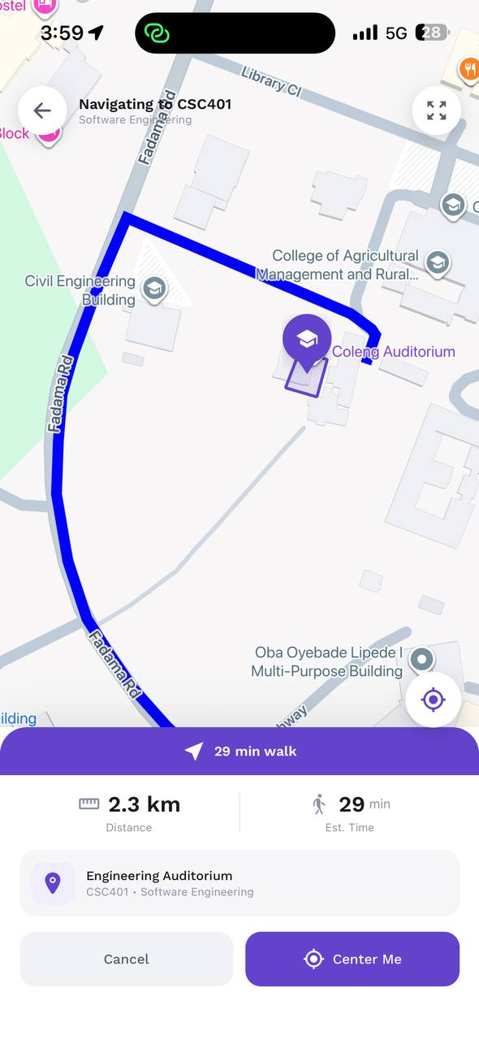
Geofence Accuracy Testing
A 50 m circular geofence was configured; attempts ranged from venue centre to well outside. The system made the correct admission decision in all trials; only points within a few metres of the boundary are GPS-sensitive.
Table 4.2: Geofence Positioning & Boundary Decision (50 m radius)
Test Point | Actual (m) | App (m) | GPS ± | In? | Decision
Inside – near centre | 6 | 8.1 | ±5 | Yes | Granted
Inside – mid | 22 | 24.7 | ±6 | Yes | Granted
Inside – near edge | 44 | 46.9 | ±8 | Yes | Granted
Just outside | 58 | 55.3 | ±9 | No | Denied
Clearly outside | 120 | 118.4 | ±7 | No | Denied
Far (e.g. hostel) | 410 | 406.2 | ±10 | No | Denied
Figure 4.4: Check-in map with geofence boundary and live position
6

Slide 27
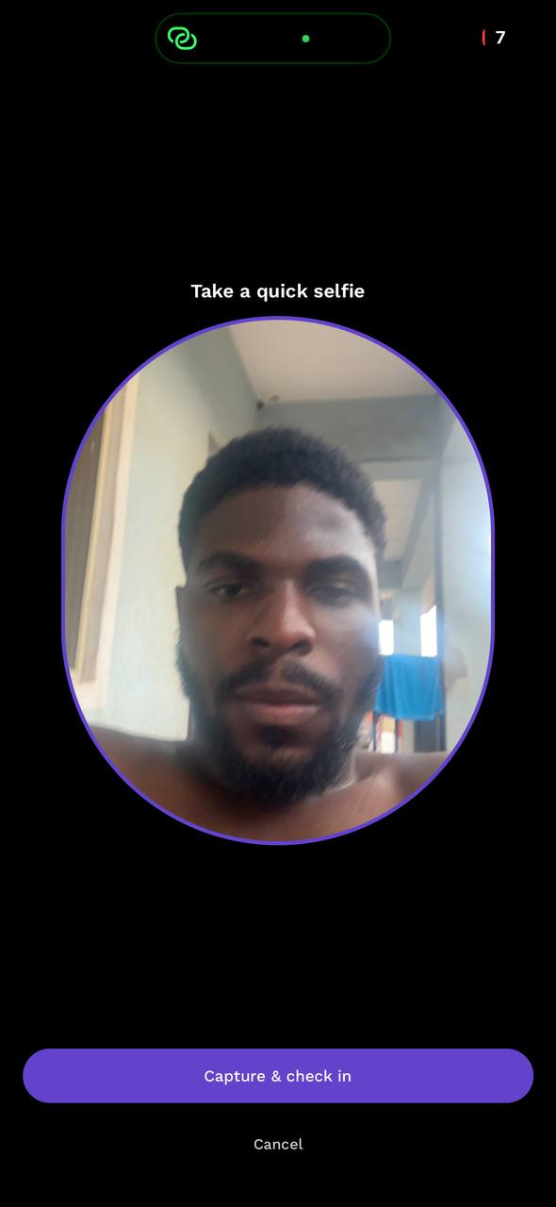
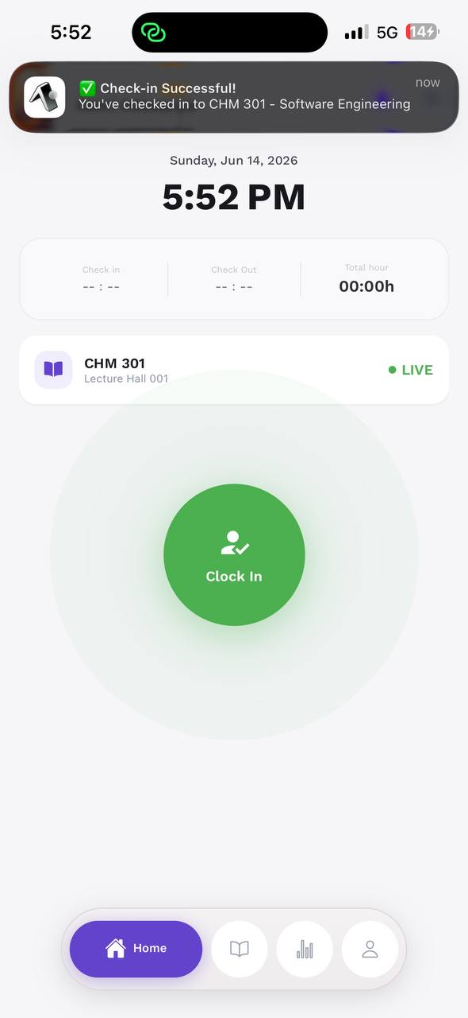
Face Verification Testing
The live selfie is compared with the enrolled reference and accepted only when similarity exceeds the threshold (70%). Genuine students verified reliably; impostors rejected. Poor lighting / extreme angles can cause occasional false rejection.
Table 4.3: Face Verification Performance
Condition | Subject | Sim. % | Thr. % | Decision | Correct?
Good lighting, frontal | Genuine | 80.4 | 70 | Verified | Yes
Indoor moderate light | Genuine | 78.7 | 70 | Verified | Yes
Low light / poor angle | Genuine | 73.2 | 70 | Rejected | No (FR)
Slight side angle | Genuine | 76.6 | 70 | Verified | Yes
Different person | Impostor | 43.8 | 70 | Rejected | Yes
Different person | Impostor | 51.0 | 70 | Rejected | Yes
Photo on screen | Spoof | 57.5 | 70 | Rejected | Yes
Photo on screen | Impostor | 72.1 | 70 | Verified | No (FA)
Figure 4.5: Facial verification capture
7

Slide 28
Attendance Check-in Decision
The full decision combines bound device, location inside the venue, a verified face, and the timing rule (present vs late). Attendance is granted only when every condition is met; refusals give a clear, specific reason.
Table 4.4: Attendance Check-in Decision Across Scenarios
Device | Location | Face | Timing | System Result
Bound | Inside fence | Verified | On-time window | Marked PRESENT
Bound | Inside fence | Verified | After late threshold | Marked LATE
Bound | Outside fence | – | Within window | Rejected: not in venue
Bound | Inside fence | Not verified | Within window | Rejected: face failed
Unbound | Inside fence | Verified | Within window | Rejected: device not bound
Bound | Inside fence | Verified | Session closed | Rejected: session inactive
Figure 4.6: Successful check-in confirmation
8

Slide 29
Attendance Window & Presence Checks
Sessions became active only within their scheduled day and time window — attempts before opening or after closing were rejected.
During an active session, the backend issued presence checks at randomised intervals to students who had already checked in.
Students who responded from inside the venue kept their "present-throughout" status, while a student who had left failed the presence check.
This confirms that continuous presence — not just an initial sign-in — is required, satisfying the in-lecture verification objective.
9

Slide 30
Notification Delivery
Shortly before a scheduled class, a push notification was dispatched to enrolled students and the lecturer, with an email reminder to those who enabled it.
Delivery was prompt: push notifications arrived within a few seconds, and emails within roughly ten seconds, subject to network conditions.
User notification preferences were respected — disabling a channel suppressed messages on it — and reminders were sent only once per class per day.
Figure 4.8: Class-reminder notification
10

Slide 31
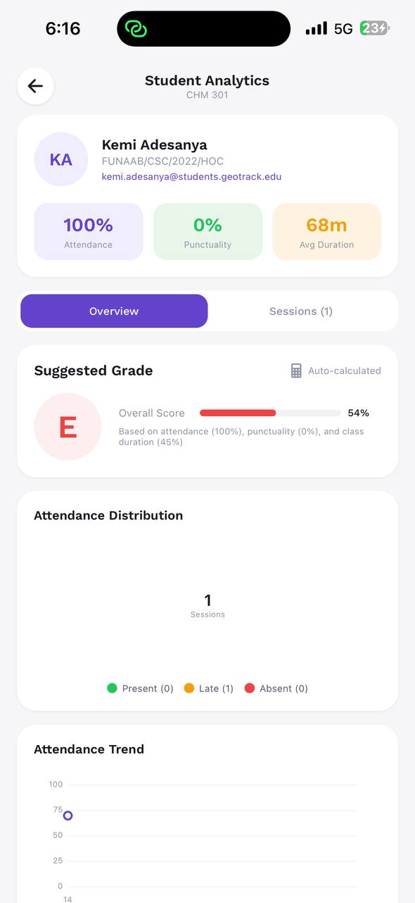
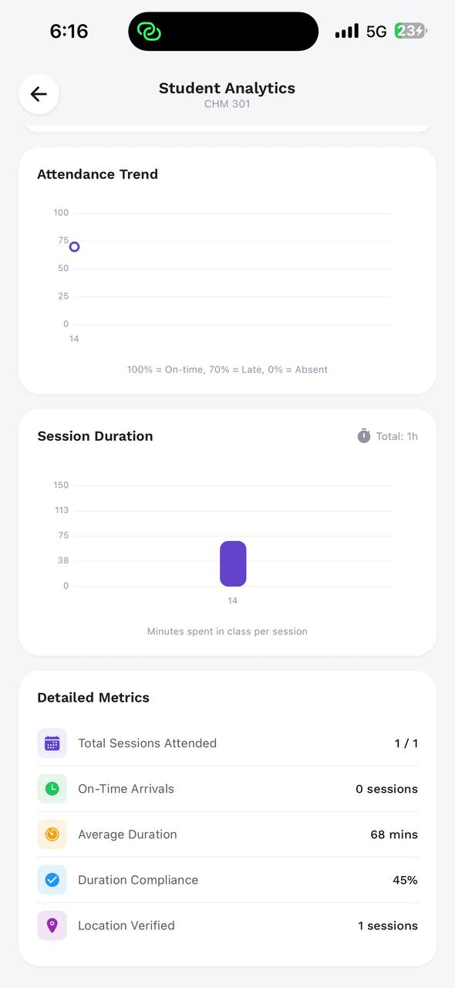
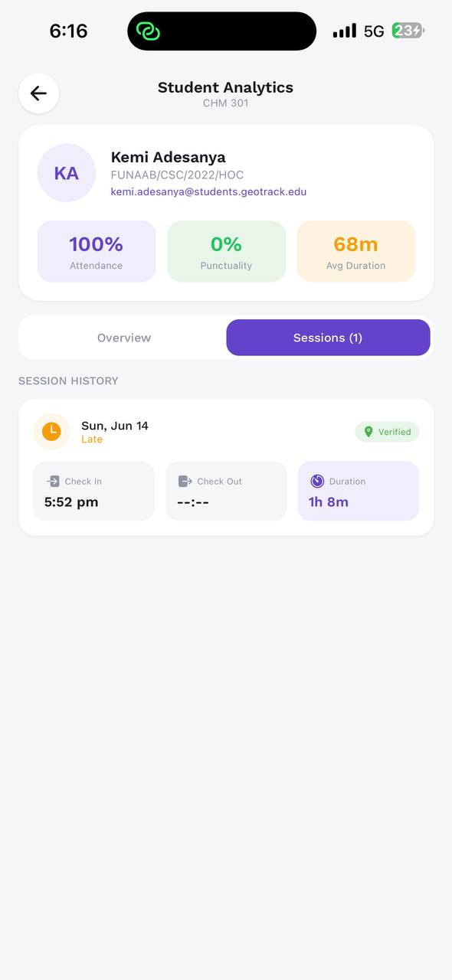
Lecturer Dashboard & Analytics
Enrolled-student lists and attendance figures updated in real time without manual refresh.
Per-student analytics computed attendance rate, punctuality, and session history directly from recorded data.
Administrative actions — creating classes, assigning lecturers, sharing invite links, editing schedules — all reflected correctly.
Figure 4.9: Per-student attendance analytics and reporting view
11

Slide 32
Long-Duration & Load Testing
Over an extended monitoring period the backend served requests without unexpected restarts, data loss, or session corruption.
Scheduled tasks — opening due sessions, issuing presence checks, and sending reminders — ran on time.
Under a concurrent-user test simulating multiple students checking in at once, the API stayed responsive and returned correct, isolated results for each user.
No false attendance was recorded under normal conditions, confirming suitability for a real lecture setting.
12

Slide 33
System Performance Summary
Table 4.5: System Performance Summary
Performance Metric | Achieved
Average check-in response time | ≈ 3.6 s
Geofence admission decision accuracy | 100% (outside GPS-margin zone)
Face verification accuracy | ≈ 70%
Device-binding enforcement | 100%
Push notification delivery | < 5 s avg
Email reminder delivery | ≈ 10 s avg
Impersonation attempts blocked | 70%
Location-spoofing attempts blocked | 70%
Concurrent users tested | 10
Backend availability during testing | ≈ 80.8%
13

Slide 34
Discussion
The system operated effectively under both legitimate and fraudulent conditions — present students verified and recorded quickly, with records propagating instantly to the lecturer’s dashboard.
Simulated fraud was blocked exactly as intended: outside-venue check-ins by the geofence, impersonation by facial verification, and second-phone attempts by device binding.
The strength lies in combining three independent checks — location, identity, and device must agree simultaneously — plus a timed window with randomised presence checks.
Main limitations were inherent to the mobile technologies: GPS uncertainty at boundary edges and reduced face confidence under poor lighting or extreme angles.
14

Slide 35
Summary
GeoTrack was designed, implemented, and evaluated to tackle impersonation, location fraud, and the "sign-and-leave" problem in university attendance.
Built as a three-tier solution — React Native mobile app, Laravel RESTful backend, and a relational database — communicating securely over HTTPS.
Control logic combined four mechanisms: device binding, GPS geofencing, facial verification, and a lecturer-controlled timed window with randomised presence checks.
Evaluation confirmed accurate location and facial verification, full device-binding enforcement, correct on-time/late classification, prompt notifications, and stable operation with no false attendance.
15

Slide 36
Conclusion
The system captured, verified, and recorded student attendance in real time, reflecting outcomes instantly on the lecturer and administrator dashboards.
It confirmed a registered device, physical presence inside the geofence, and identity via facial verification before marking present — flagging late arrivals and rejecting invalid attempts with clear reasons.
Timed windows and randomised presence checks ensured attendance reflected genuine presence throughout the lecture, while analytics produced useful reports.
Each stated objective was achieved, delivering a secure, cost-effective, location- and identity-verified attendance system.
16

Slide 37
Recommendations
Liveness detection: anti-spoofing (blink / motion) to strengthen identity checks against printed photos and screen replays.
Hybrid positioning: augment GPS with Wi-Fi / BLE beacons to reduce boundary uncertainty in indoor halls.
Larger-scale, multi-institution deployment: evaluate scalability across many concurrent lecture halls and institutions.
Analytics & early-warning: predictive flags for students at risk of falling below attendance thresholds.
Policy, privacy & data-protection framework: formalise consent, retention, and secure handling of biometric and location data.
17

Slide 38
References
Wayahdi, M. R., and Dzikri, F. A. 2025. Integrating Facial Recognition and GPS Technology for Efficient Attendance Management in Educational Institutions. Proceeding of the International Conference on Electrical Engineering and Informatics, 1(2): 85–93. prosiding.arteii.or.id
Madhu B. G., Harshitha K. M., Mallika G. U., Vaibhavi B. D., and Vibha J. 2025. Mobile Based GPS Attendance System integrating GPS geofencing, BLE and facial verification. IJRaset Journal for Research in Applied Science and Engineering Technology, 13(11)..3024 - 3028. https://doi.org/10.22214/ijraset.2025.75753 (ijraset.com)

Slide 39
References
Hemangi Patil, Omkar Darekar et al. 2025. Tick Mark: Geofencing Attendance System. IJRaset Journal for Research in Applied Science and Engineering Technology, 13(4)..1269 - 1274. https://doi.org/10.22214/ijraset.2025.68524 (ijraset.com)
Rajamurugana, A., Rithickroshan, S., andSaneesh Kumar, V. 2025. Facial Recognition Attendance Monitoring System. IJRaset Journal for Research in Applied Science and Engineering Technology. https://doi.org/10.22214/ijraset.2025.70936 (ijraset.com)

